Slide 1

Asynchronous Data Transfer
Computer Organization and Architecture | Memory & I/O Organization
Computer Organization and Architecture | Memory & I/O Organization | Bachelor of Engineering
DISCOVER · LEARN · EMPOWER
Notes:
Welcome to today's lecture on Asynchronous Data Transfer within the Memory and I/O Organization chapter. We will explore how devices with different speeds communicate without a shared clock. This is a fundamental concept for understanding real-world hardware interactions in your engineering projects.

Slide 2
Course Outcomes
SLIDE 2 / 10
Course Outcome
CO | BT LEVEL | DESCRIPTION
CO1 | BT3 | Apply number systems and digital logic to design basic digital circuits
CO2 | BT4 | Analyze register organization and instruction set architecture
CO3 | BT3 | Implement computer arithmetic algorithms and floating-point operations
CO4 | BT5 | Analyze memory hierarchy and input-output organization
CO5 | BT6 | Evaluate control unit design and pipelining performance
Chandigarh University
2 / 10
Notes:
This lecture directly addresses Course Outcome 4, which requires you to analyze memory hierarchy and input-output organization. By understanding asynchronous transfer, you will be able to evaluate how different I/O devices interact with the processor. This skill is crucial for designing efficient computer systems.

Slide 3
Learning Objectives
SLIDE 3 / 10
Learning Outcomes
1
Analyze the fundamental differences between synchronous and asynchronous data transfer mechanisms.
2
Evaluate the necessity of handshaking signals for coordinating data exchange between devices.
3
Examine the specific roles of Read and Write strobes in asynchronous operations.
4
Assess the impact of variable device speeds on system performance and timing.
Chandigarh University
3 / 10
Notes:
By the end of this session, you will be able to analyze the core differences between synchronous and asynchronous methods. You will evaluate why handshaking is essential when devices operate at different speeds. We will also examine how Read and Write strobes function as the primary control signals in these transfers.

Slide 4
Lecture
SLIDE 4 / 10
Definition of Asynchronous Transfer
1
Asynchronous transfer occurs without a common clock signal between source and destination.
2
Data transfer relies on control signals to indicate when data is valid.
3
The source device sends data only when the destination is ready to receive.
4
This method accommodates devices with widely varying operational speeds effectively.
5
It eliminates the need for complex clock synchronization circuits in the system.
Chandigarh University
4 / 10
Notes:
Unlike synchronous transfer, asynchronous transfer does not use a shared clock. Instead, the source device sends data only when the destination is ready. Think of it like a conversation where you wait for the other person to nod before speaking, rather than speaking on a strict beat.

Slide 5
Lecture
SLIDE 5 / 10
Handshaking Mechanism
1
Handshaking uses control signals to coordinate data transfer between two devices.
2
The Read strobe (RD) indicates the processor is requesting data from I/O.
3
The Write strobe (WR) indicates the processor is sending data to I/O.
4
The Ready signal confirms the I/O device is prepared for the operation.
5
Data is transferred only when both the strobe and ready signals are active.
Chandigarh University
5 / 10
Notes:
The handshaking mechanism ensures data integrity by coordinating the transfer. The Read strobe tells the I/O device the processor wants data, while the Write strobe indicates the processor is sending data. The Ready signal acts as a gate, ensuring the device is prepared before data moves.

Slide 6
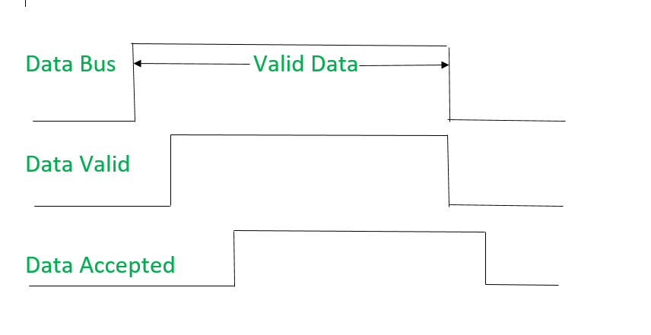
Lecture
SLIDE 6 / 10
Read Operation Sequence
1
The processor asserts the Read strobe signal to initiate a data read request.
2
The I/O device detects the strobe and places valid data on the bus.
3
The processor waits for the I/O Ready signal to confirm data validity.
4
Once ready, the processor reads the data and then de-asserts the strobe.
5
The I/O device removes data from the bus after the strobe is released.
Asynchronous I/O Synchronization - GeeksforGeeks (source: media.geeksforgeeks.org)
Chandigarh University
6 / 10
Notes:
In a read operation, the processor first asserts the Read strobe to request data. The I/O device then places valid data on the bus and waits for the processor to acknowledge. The processor reads the data only after receiving the Ready signal, ensuring no data is lost.

Slide 7
Lecture
SLIDE 7 / 10
Write Operation Sequence
1
The processor places data on the bus and asserts the Write strobe signal.
2
The I/O device detects the strobe and begins capturing the data bits.
3
The processor waits for the I/O Ready signal before releasing the strobe.
4
Once ready, the processor de-asserts the strobe to complete the write cycle.
5
The I/O device retains the data after the strobe signal is removed.
Chandigarh University
7 / 10
Notes:
For a write operation, the processor places data on the bus and asserts the Write strobe. The I/O device captures this data and signals readiness. The processor holds the strobe until the Ready signal confirms the data has been safely stored, then releases it.

Slide 8
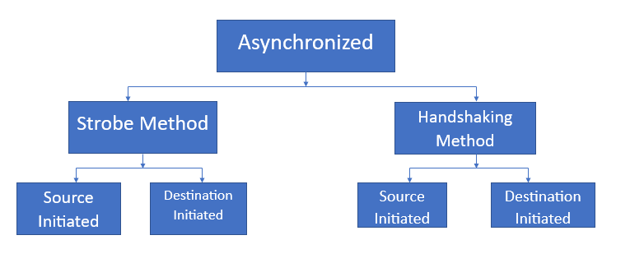
Lecture
SLIDE 8 / 10
Timing and Performance Analysis
GOVERNING EQUATION
T_total = T_setup + T_hold + T_processing + T_response
1
Total transfer time equals the sum of setup time and hold time delays.
2
Performance depends on the slowest device in the communication path.
3
Faster processors must wait for slower I/O devices during each transfer.
4
This waiting period reduces the overall system throughput compared to synchronous methods.
Asynchronous Data Transfer - GeeksforGeeks (source: media.geeksforgeeks.org)
Chandigarh University
8 / 10
Notes:
The total transfer time includes setup, hold, processing, and response delays. Performance is limited by the slowest device, meaning a fast processor must wait for a slow printer. This waiting period reduces overall throughput, but it ensures reliable data transfer across different speeds.

Slide 9
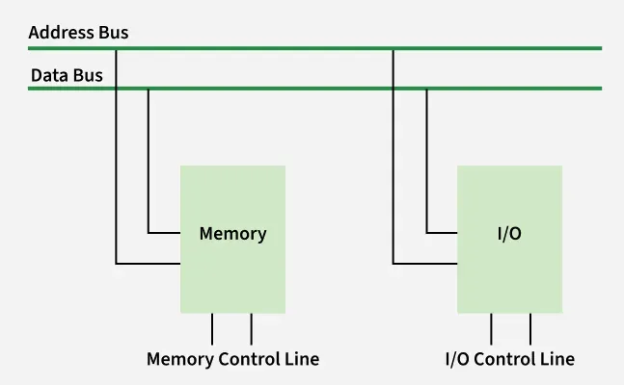
Lecture
SLIDE 9 / 10
Key Takeaways
1
Asynchronous transfer uses handshaking instead of a shared clock for coordination.
2
Read and Write strobes control the direction of data flow between devices.
3
The Ready signal ensures data is only transferred when the destination is prepared.
4
This method supports devices with widely varying operational speeds effectively.
5
System performance is limited by the slowest device in the communication path.
Source: media.geeksforgeeks.org
Chandigarh University
9 / 10
Notes:
To summarize, asynchronous transfer uses handshaking rather than a shared clock. Read and Write strobes control data flow, while the Ready signal ensures preparation. This method supports devices with varying speeds, though performance is limited by the slowest component.

Slide 10
Lecture
SLIDE 10 / 10
References
COMPUTER ORGANIZATION AND DESIGN
The Hardware/Software Interface — David A. Patterson, John L. Hennessy
COMPUTER ARCHITECTURE
A Quantitative Approach — John L. Hennessy, David A. Patterson
• Computer Organization and Architecture — William Stallings
• Computer System Architecture — M. Morris Mano & Rajib Mall
• Computer Organization — Carl Hamacher, Zvonko Vranesic, Safwat Zaky
Chandigarh University
10 / 10
Notes:
These references provide comprehensive coverage of computer organization and architecture principles. William Stallings and M. Morris Mano offer detailed explanations of I/O organization. David A. Patterson and John L. Hennessy provide quantitative approaches to system design.

